Slide 1
Difficulties in Coexistence with Wild Animals: A Brief Discussion on Future Possibilities
E-Leader Conference
Manila, Philippines
Jan. 2-4, 2012
Yukichika Kawata
Department of Animal and Food Hygiene
Obihiro University of Agriculture and Veterinary Medicine
Inada-cho, Obihiro, Hokkaido, Japan

Slide 2
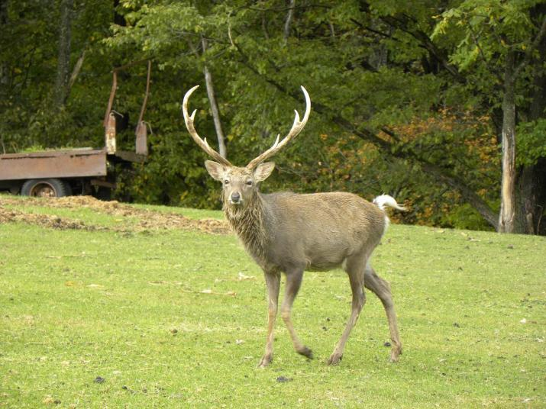
Purpose of this presentation
The purpose of this presentation is to introduce the current situation of hunting animals and to invoke wider attention and discussions associated with it in Japan.
Oct. 10th, 2009 at Deer farm, Nishiokoppe town, Hokkaido
Notes:
シカをメインに発表する

Slide 3
Contents
1. Current status
    Increase in population of ungulates
    Serious damage caused by increased population of ungulates
2. A new method to protect damage
    I introduce one efficient method for damage protection
3. Brief discussions
    I recommend to create a new habitat and rely on the ecosystem for its control to a certain extent.

Slide 4
1. Current status
Increase in population of ungulates
  Because of the absence of large carnivores (or predators) (1.1) for controlling ungulate population and a reduced hunting pressure by human hunters (1.2), the population of ungulates seem to have increased.
Damage caused by ungulates (1.3)
  Vegetation damage
  Agriculture damage
  Forestry damage
  Traffic accidents

Slide 5
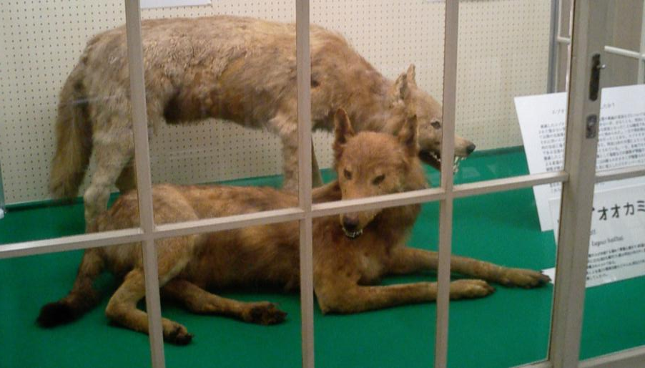
1.1 Absence of large carnivores
Yezo wolf (Canis lupus hattai Kishida, 1931) Extinct
Japanese Wolf (C. l. hodophilax Temminck, 1839) Extinct
Wild dogs (Canis lupus familiaris) Not influential
Brown bear (Ursus arctos Linnaeus, 1758) Not influential

Slide 6
1.2 Reduced hunting pressure by human hunters
The number of hunters (average of 5 years)
[please see] http://www.biodic.go.jp/cbd/5/tu3-2.PDF
The number of hunters in Japan as decreased.

Slide 7
[please see] Kawata, Y. 2011. Economic growth and trend changes in wildlife hunting. Acta agriculturae Slovenica 97(2), p. 122, Fig. 2.
JAPAN
pcGDP 39530 (2009)
Hunter rate 0.17% (2008)

Slide 8
JAPAN
Hunters’ proportion of the population
existence of sport hunting
NO
substitutes (e.g. domestic animal products)
YES
knowledge regarding the quality of game meats
NO
existence of traditional foods
NO
Per capita GDP

Slide 9
The average age of remaining hunters has increased.
Age distribution of hunters
[please see] http://www.biodic.go.jp/cbd/5/tu3-2.PDF

Slide 10
1.3 Damage caused by ungulates
Vegetation damage
  Shiretoko peninsular (Hokkaido, World heritage)
  Kiritappu wetland (Hokkaido, registered wetland under the Ramsar Convention)
  Ohdaigahara (Nara, National park, UNESCO Man and the Biosphere Reserve)
Agriculture / Forestry damages
Traffic accidents

Slide 11
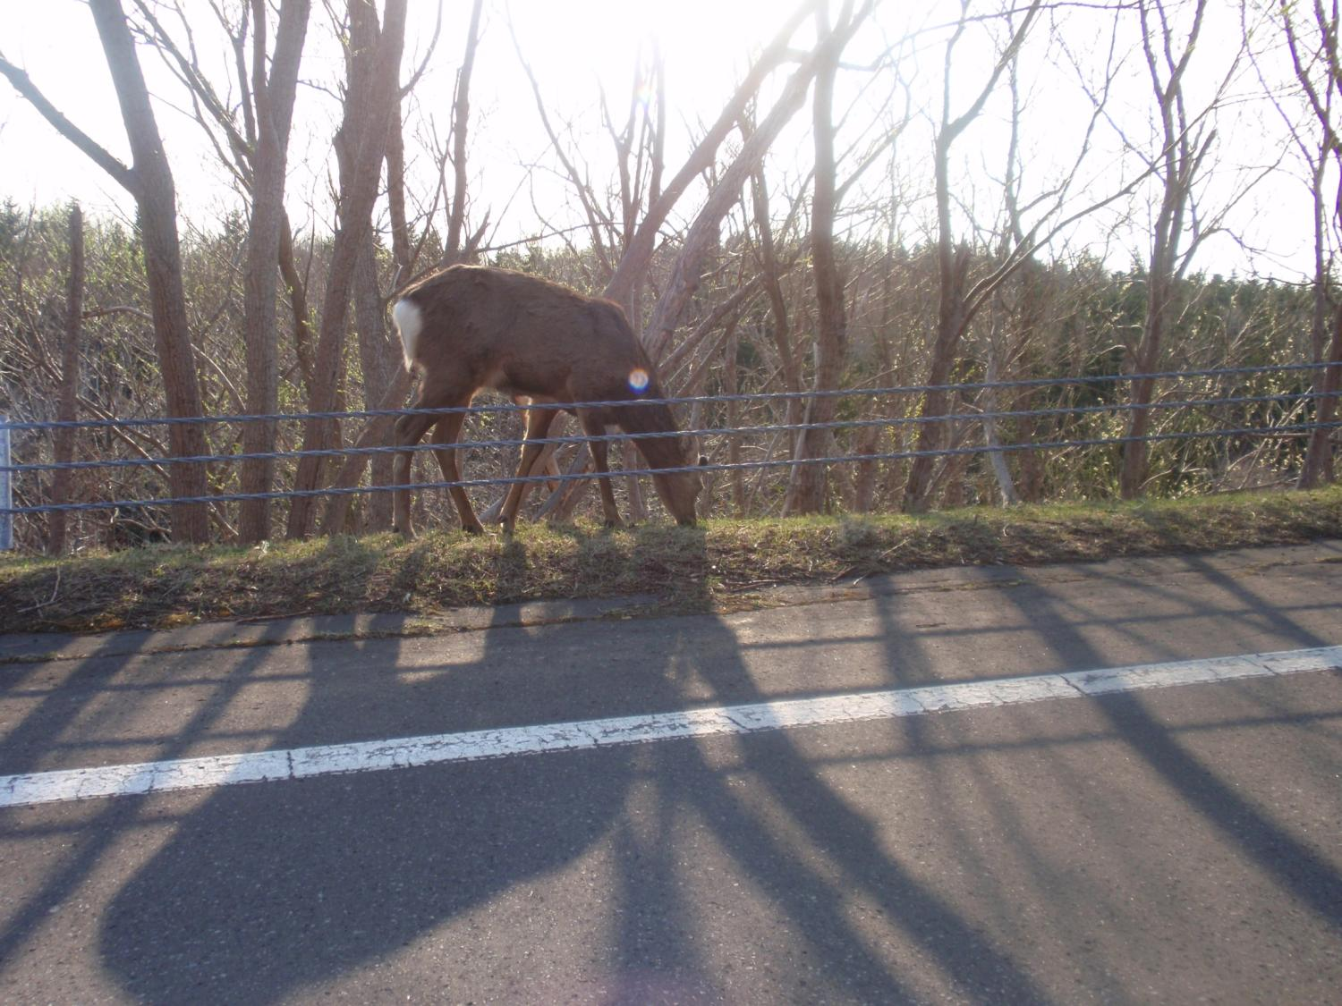
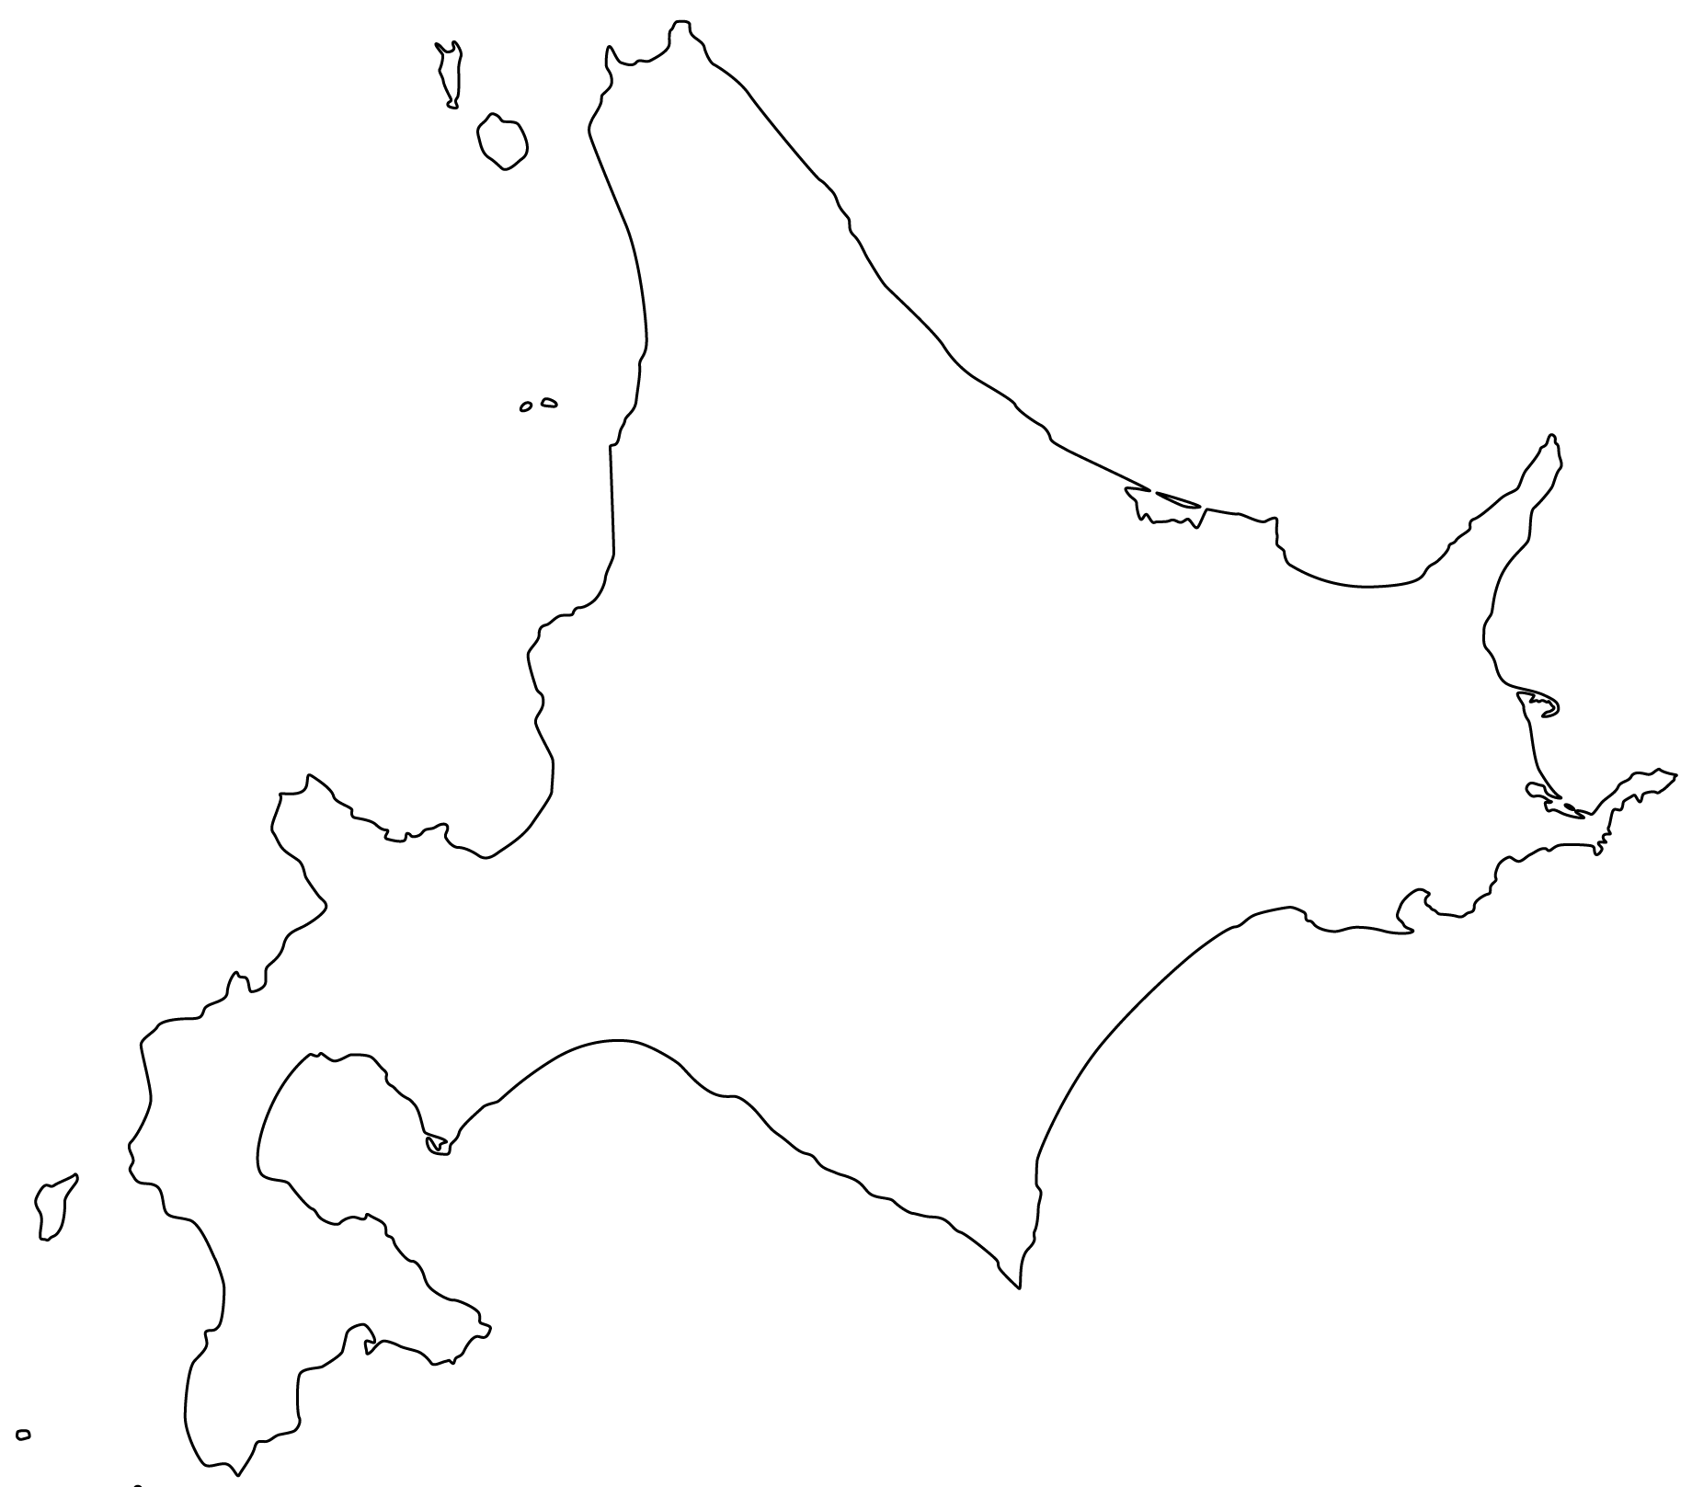
Shiretoko
Shiretoko
May 4th, 2009 by Kawata at Shiretoko

Slide 12
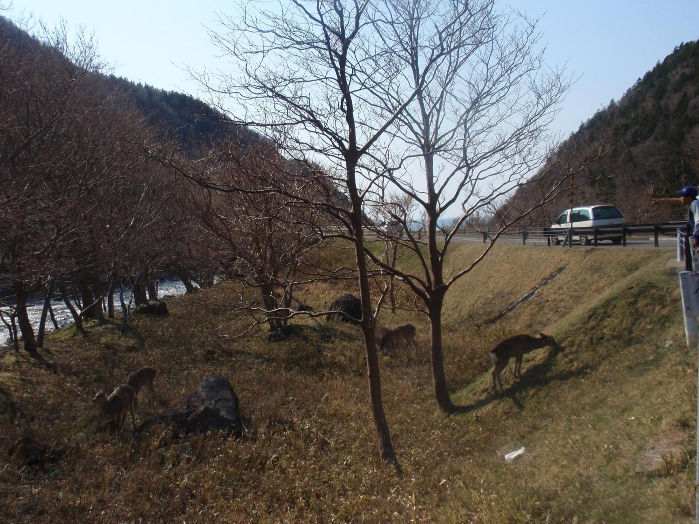
Shiretoko
May 4th, 2009 by Kawata at Shiretoko

Slide 13
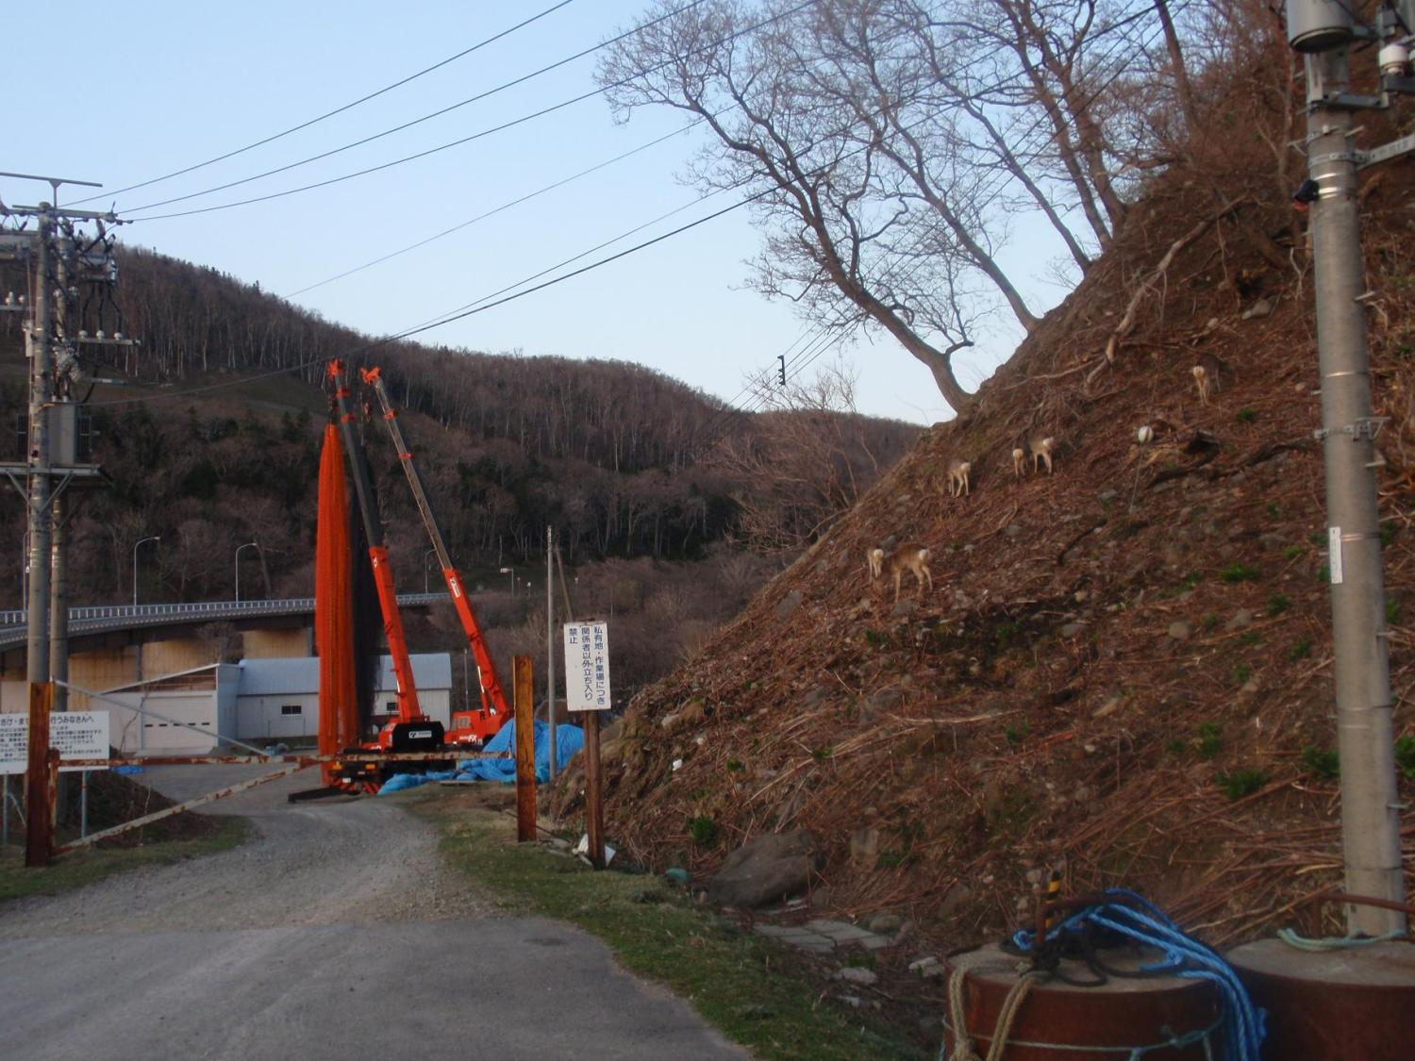
Shiretoko
May 4th, 2009 by Kawata at Shiretoko

Slide 14
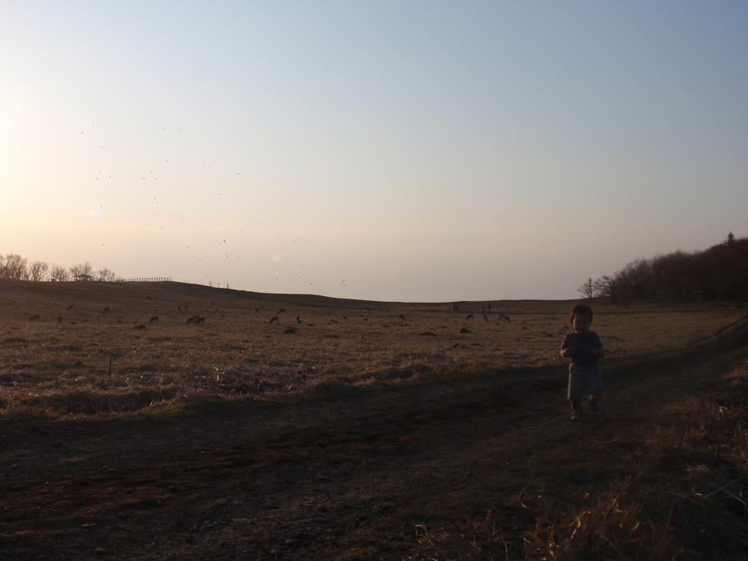
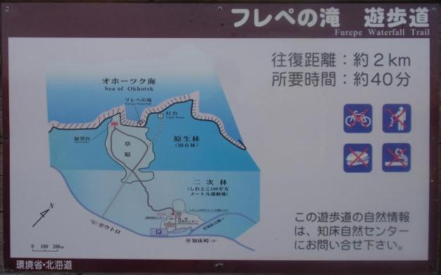
Shiretoko
May 4th, 2009 by Kawata at Shiretoko

Slide 15
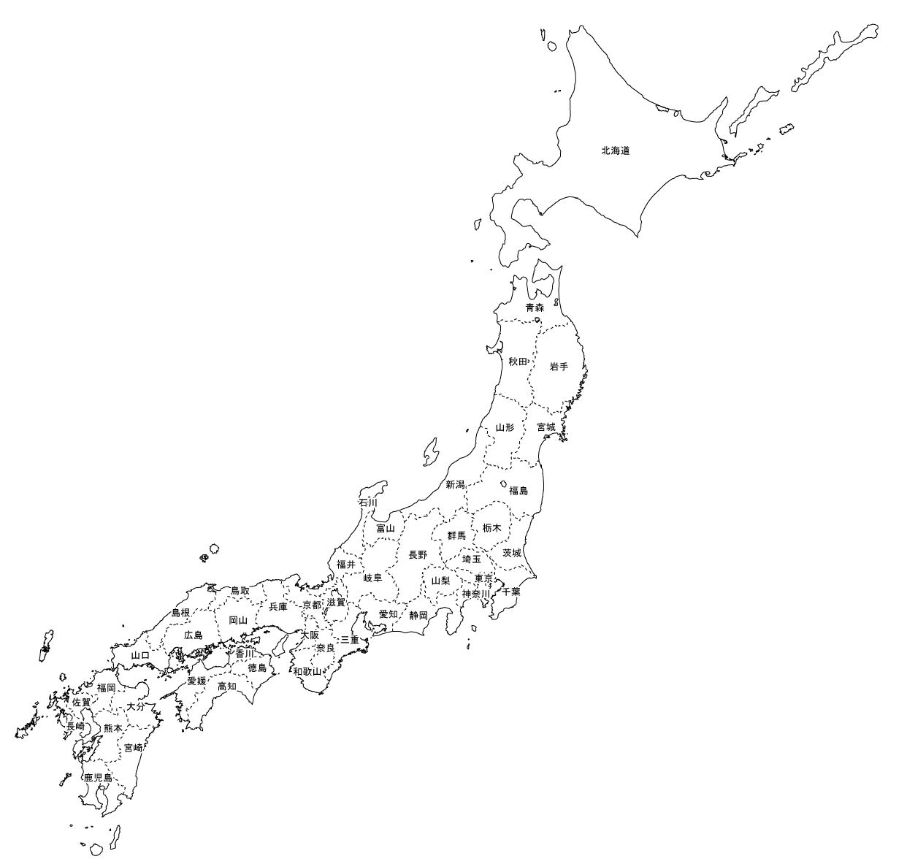
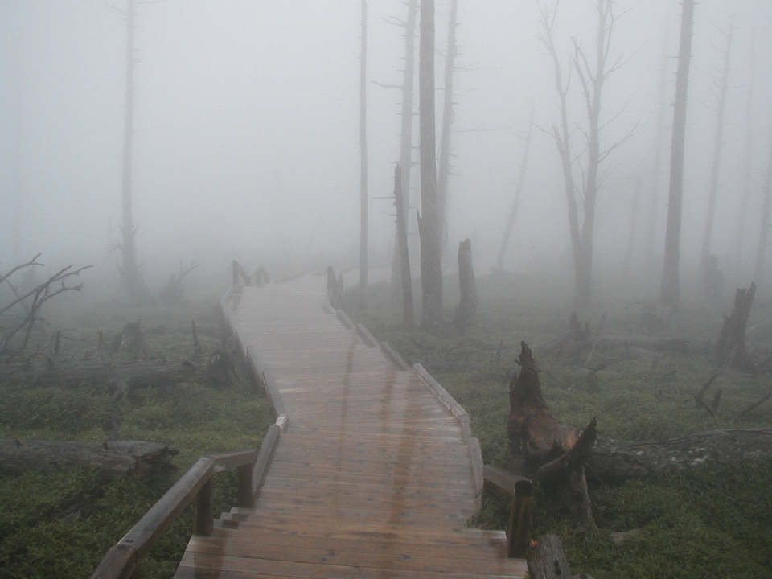
Ohdaigahara
Sept. 19, 2002 by Kawata

Slide 16
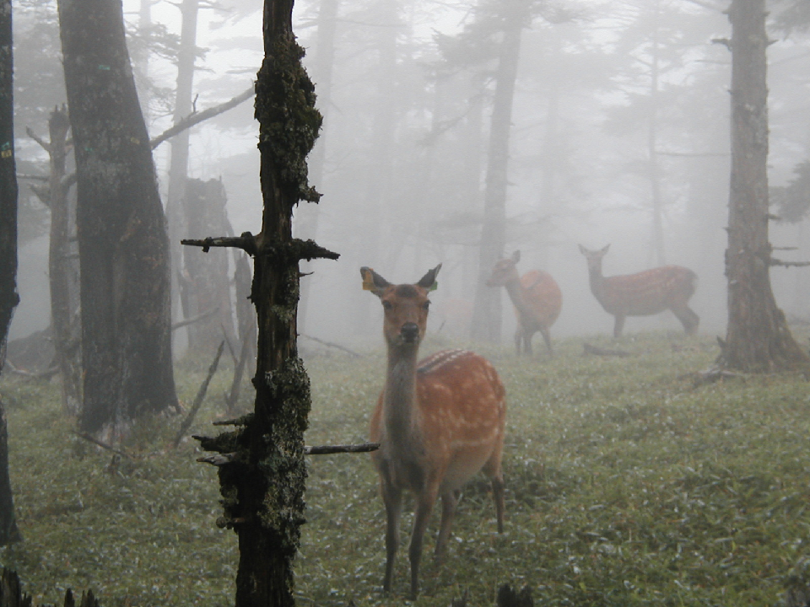
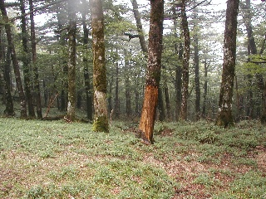
Ohdaigahara
Sept. 19, 2002 by Kawata

Slide 17
Estimated agricultural damage has increased.
Agricultural / forestry damage by the sika deer in Hokkaido
[please see] http://www.pref.hokkaido.lg.jp/ks/est/higaityousa-ezosika.pdf

Slide 18
Car accidents involving Yezo deer (Hokkaido)
[please see] Kawata, Y. 2011. An analysis of natural factors of traffic accidents involving Yezo deer (Cervus nippon yesoensis). Bulgarian Journal of Veterinary Medicine 14(1), p. 5, Fig. 2.

Slide 19
2. A new method to protect damage
Comparison of traditional methods and ours
  TRADITIONAL METHODS OUR METHOD
  Time consuming Less time consuming
  Costly Cheaper
  Need special skills Need no special skills
  Non-biodegradable (not always) Biodegradable (within few years)
  Need maintenance Need maintenance

Slide 20
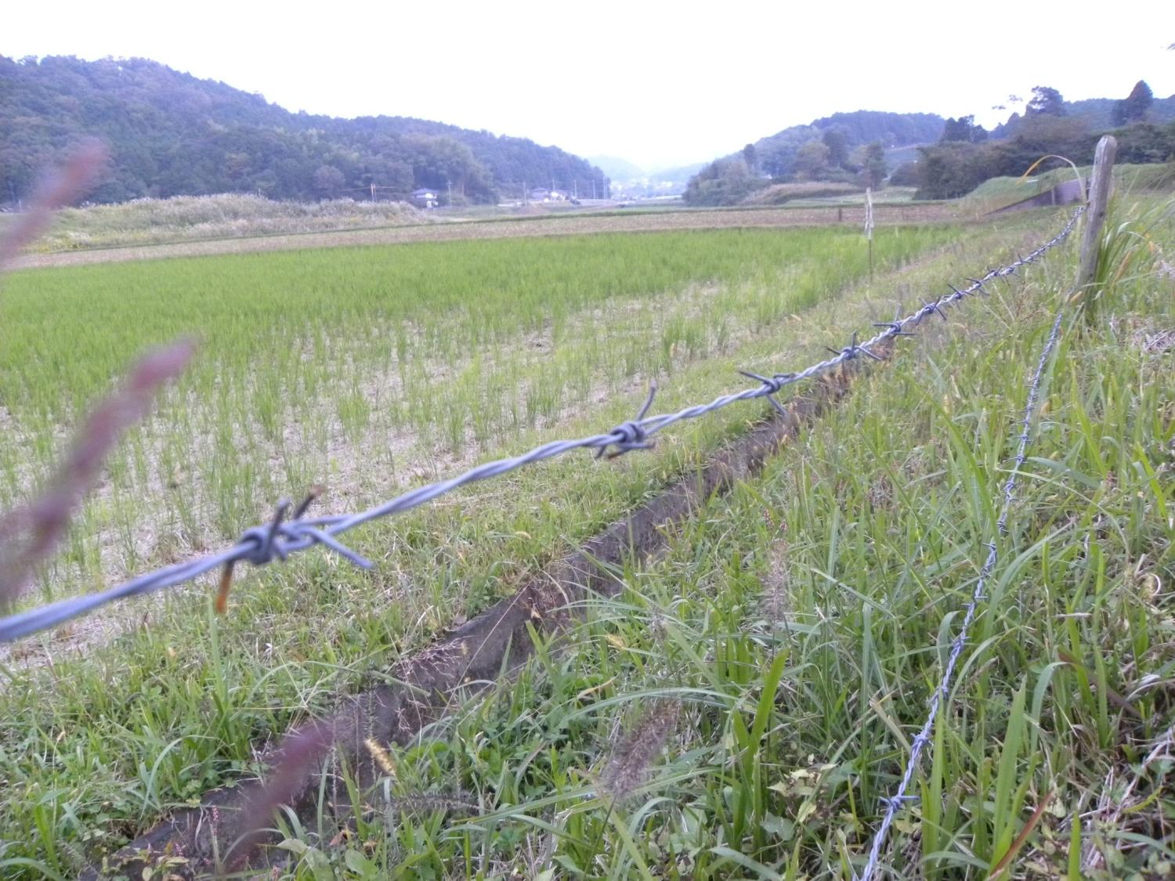
2.1 Traditional methods to protect damage
Oct. 16th, 2009 at Kyoto

Slide 21
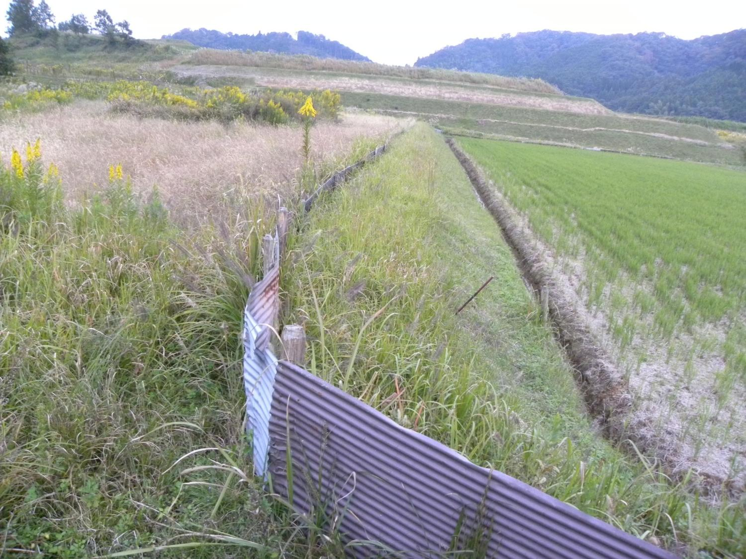
Oct. 16th, 2009 at Kyoto

Slide 22
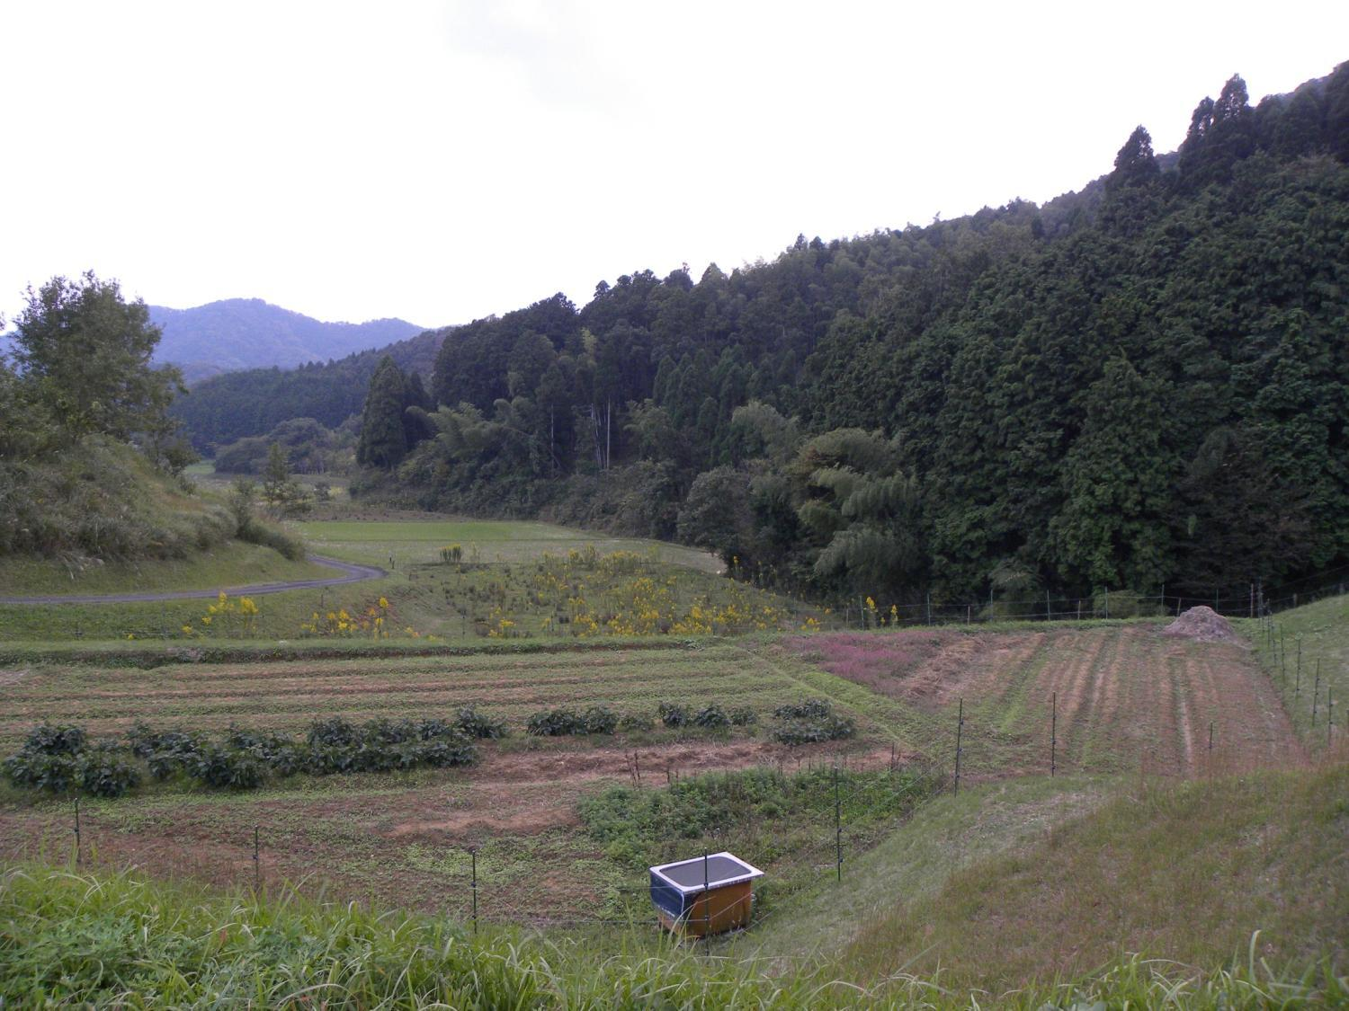
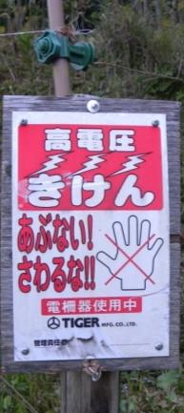
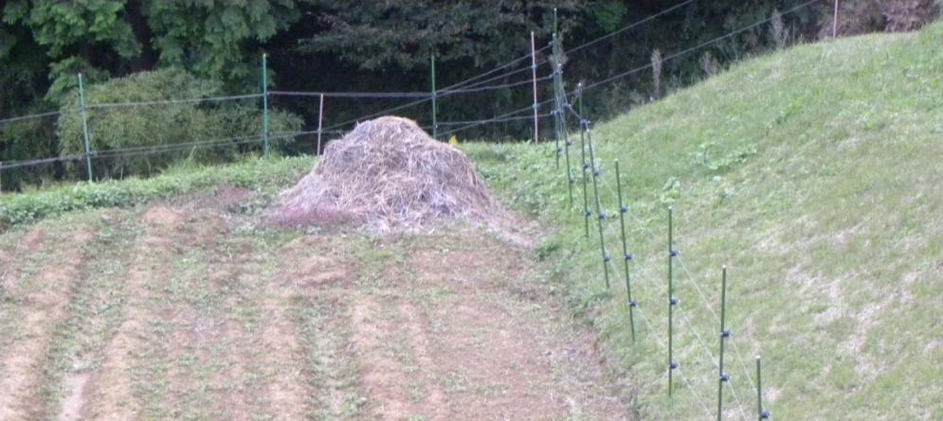
Oct. 16th, 2009 at Kyoto

Slide 23
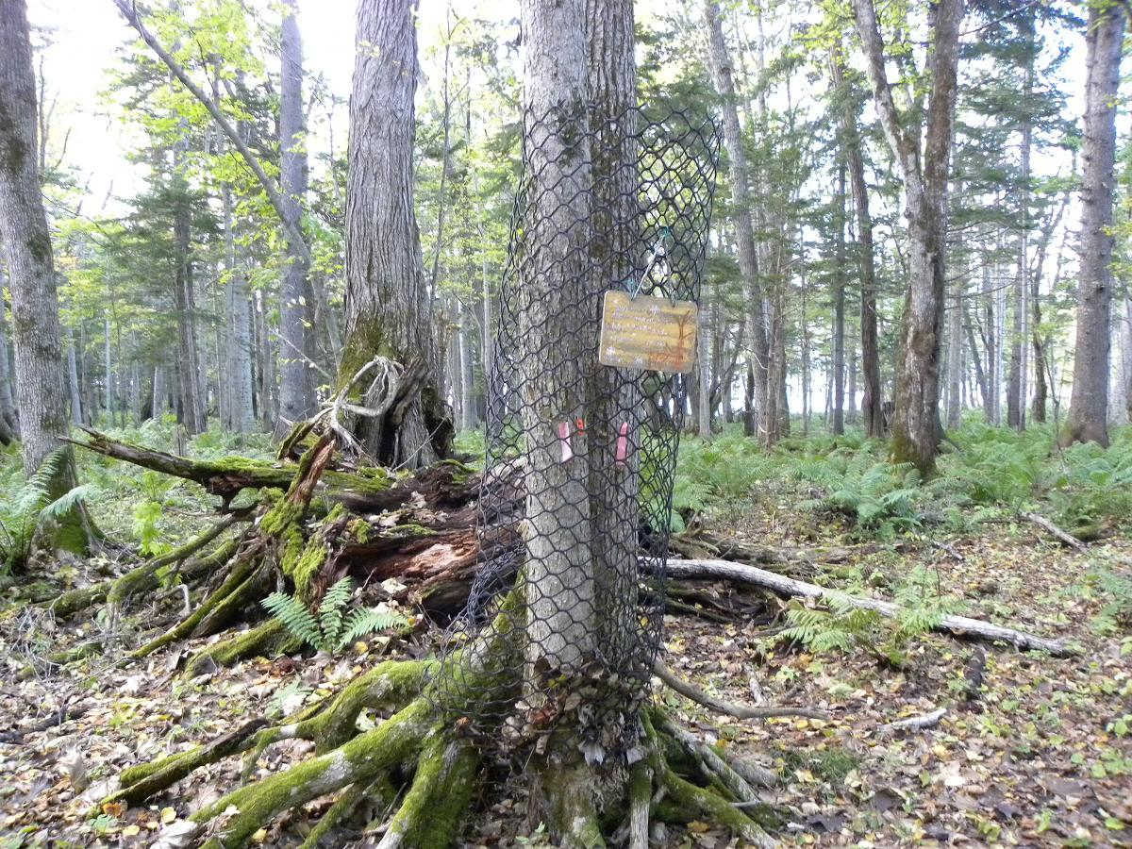
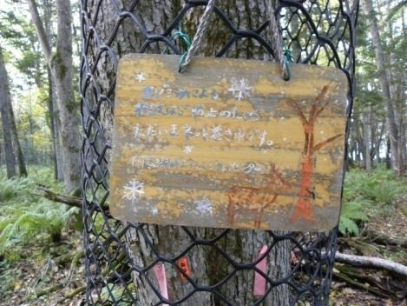
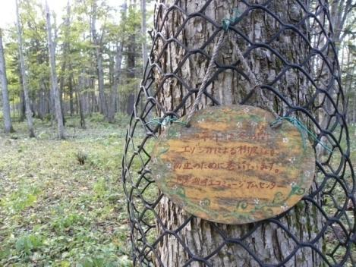
Oct. 11th, 2009 at Akan National Park, Hokkaido

Slide 24
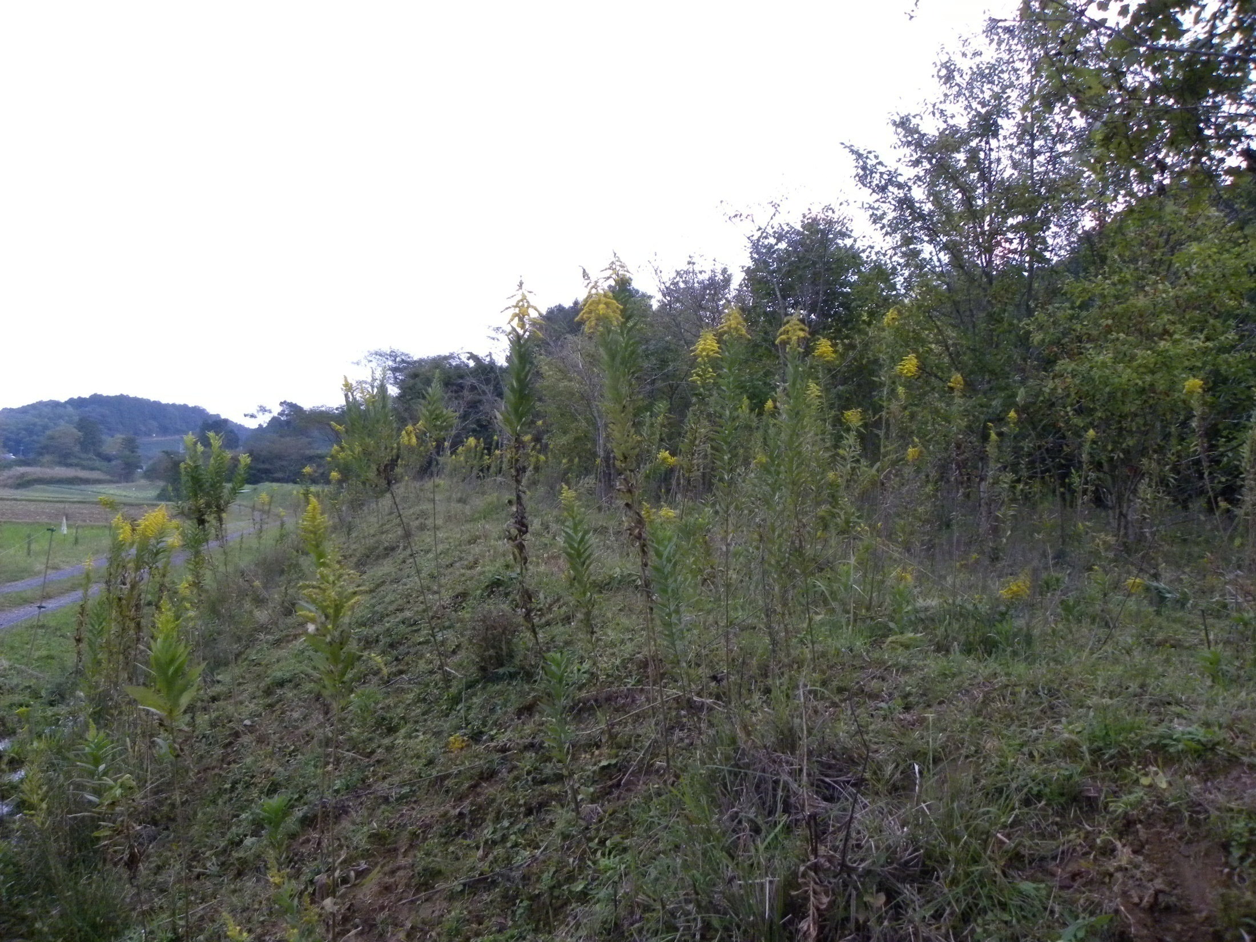
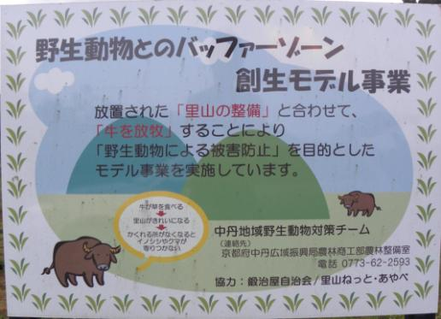
BEFORE
Forests
Cultivated lands
AFTER
Forests
Cultivated lands
STOP

Slide 25
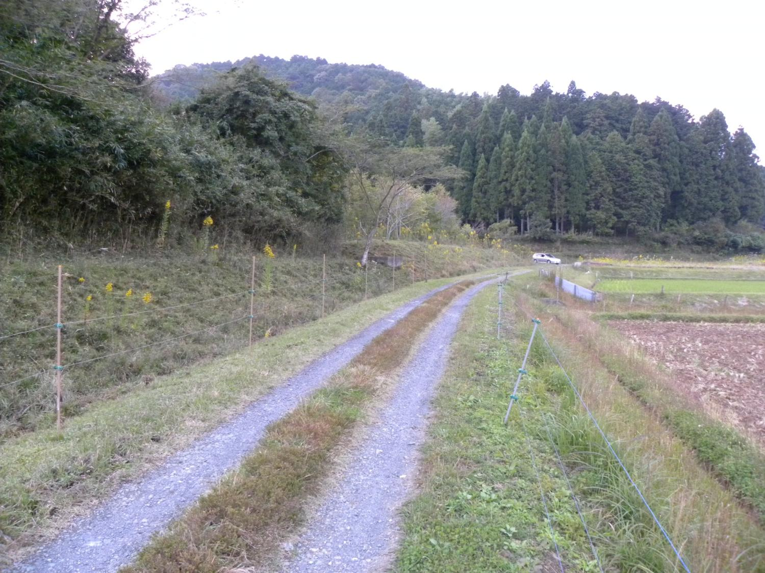
Cows are here
Oct. 16th, 2009 at Kyoto

Slide 26
2.2 A new method to protect damage
The sika deer select foods for eating when the benefit (calorie obtained) of foods is far larger than the cost (calories consumed) of consuming them.
Outside
benefit
Outside
cost
cost
benefit
Inside
Inside

Slide 27
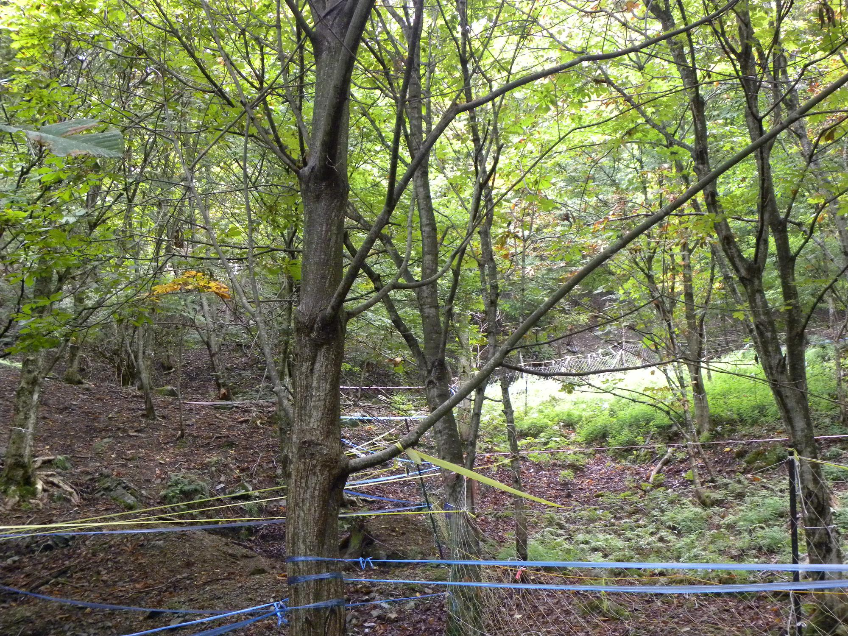
Outside
Inside (protected area)
Sept. 17th, 2011 at Kyoto

Slide 28
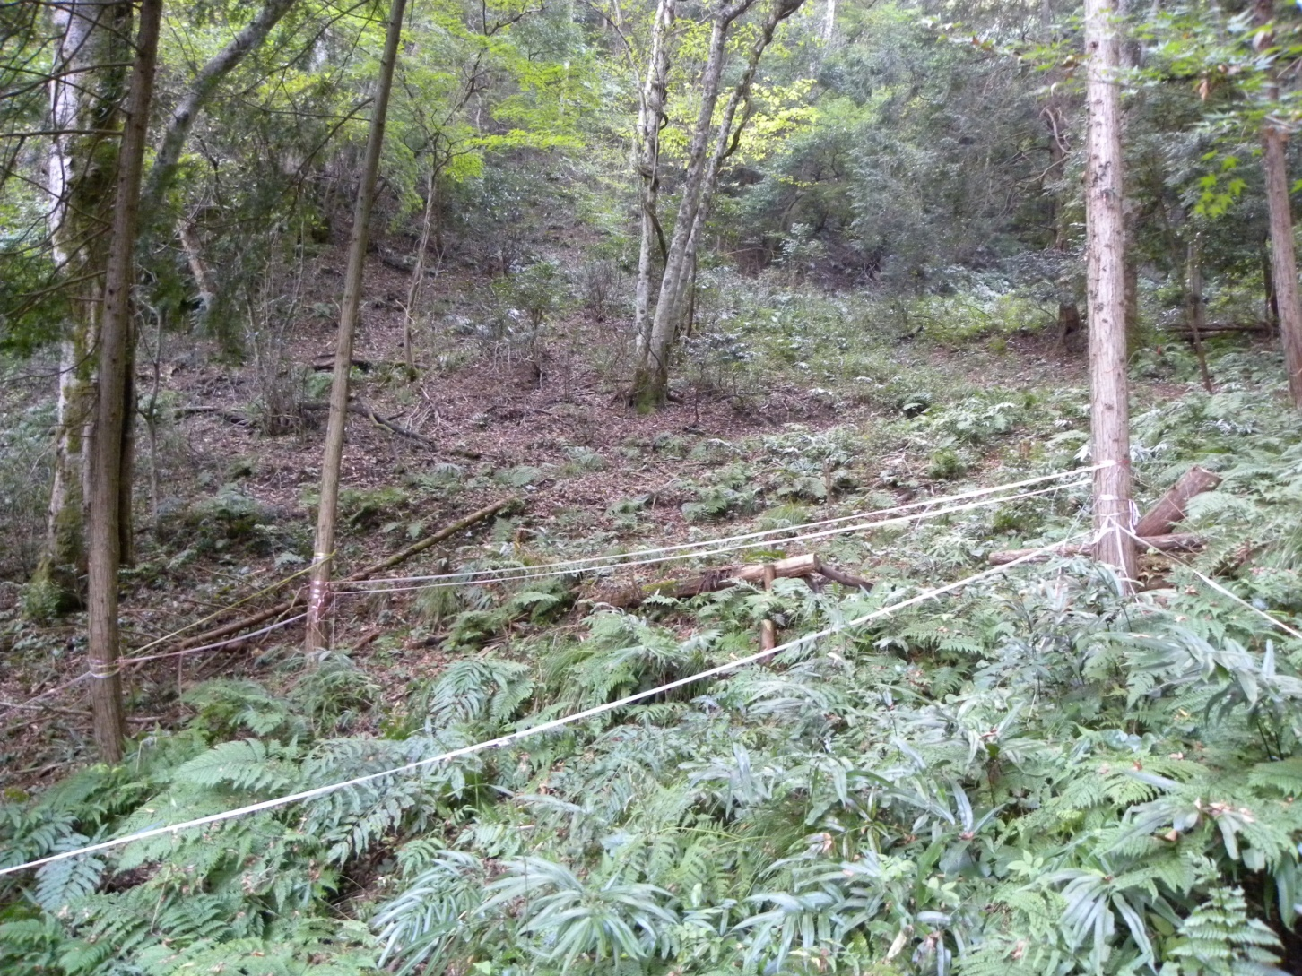
Outside
Inside (protected area)
Oct. 16th, 2009 at Kyoto

Slide 29
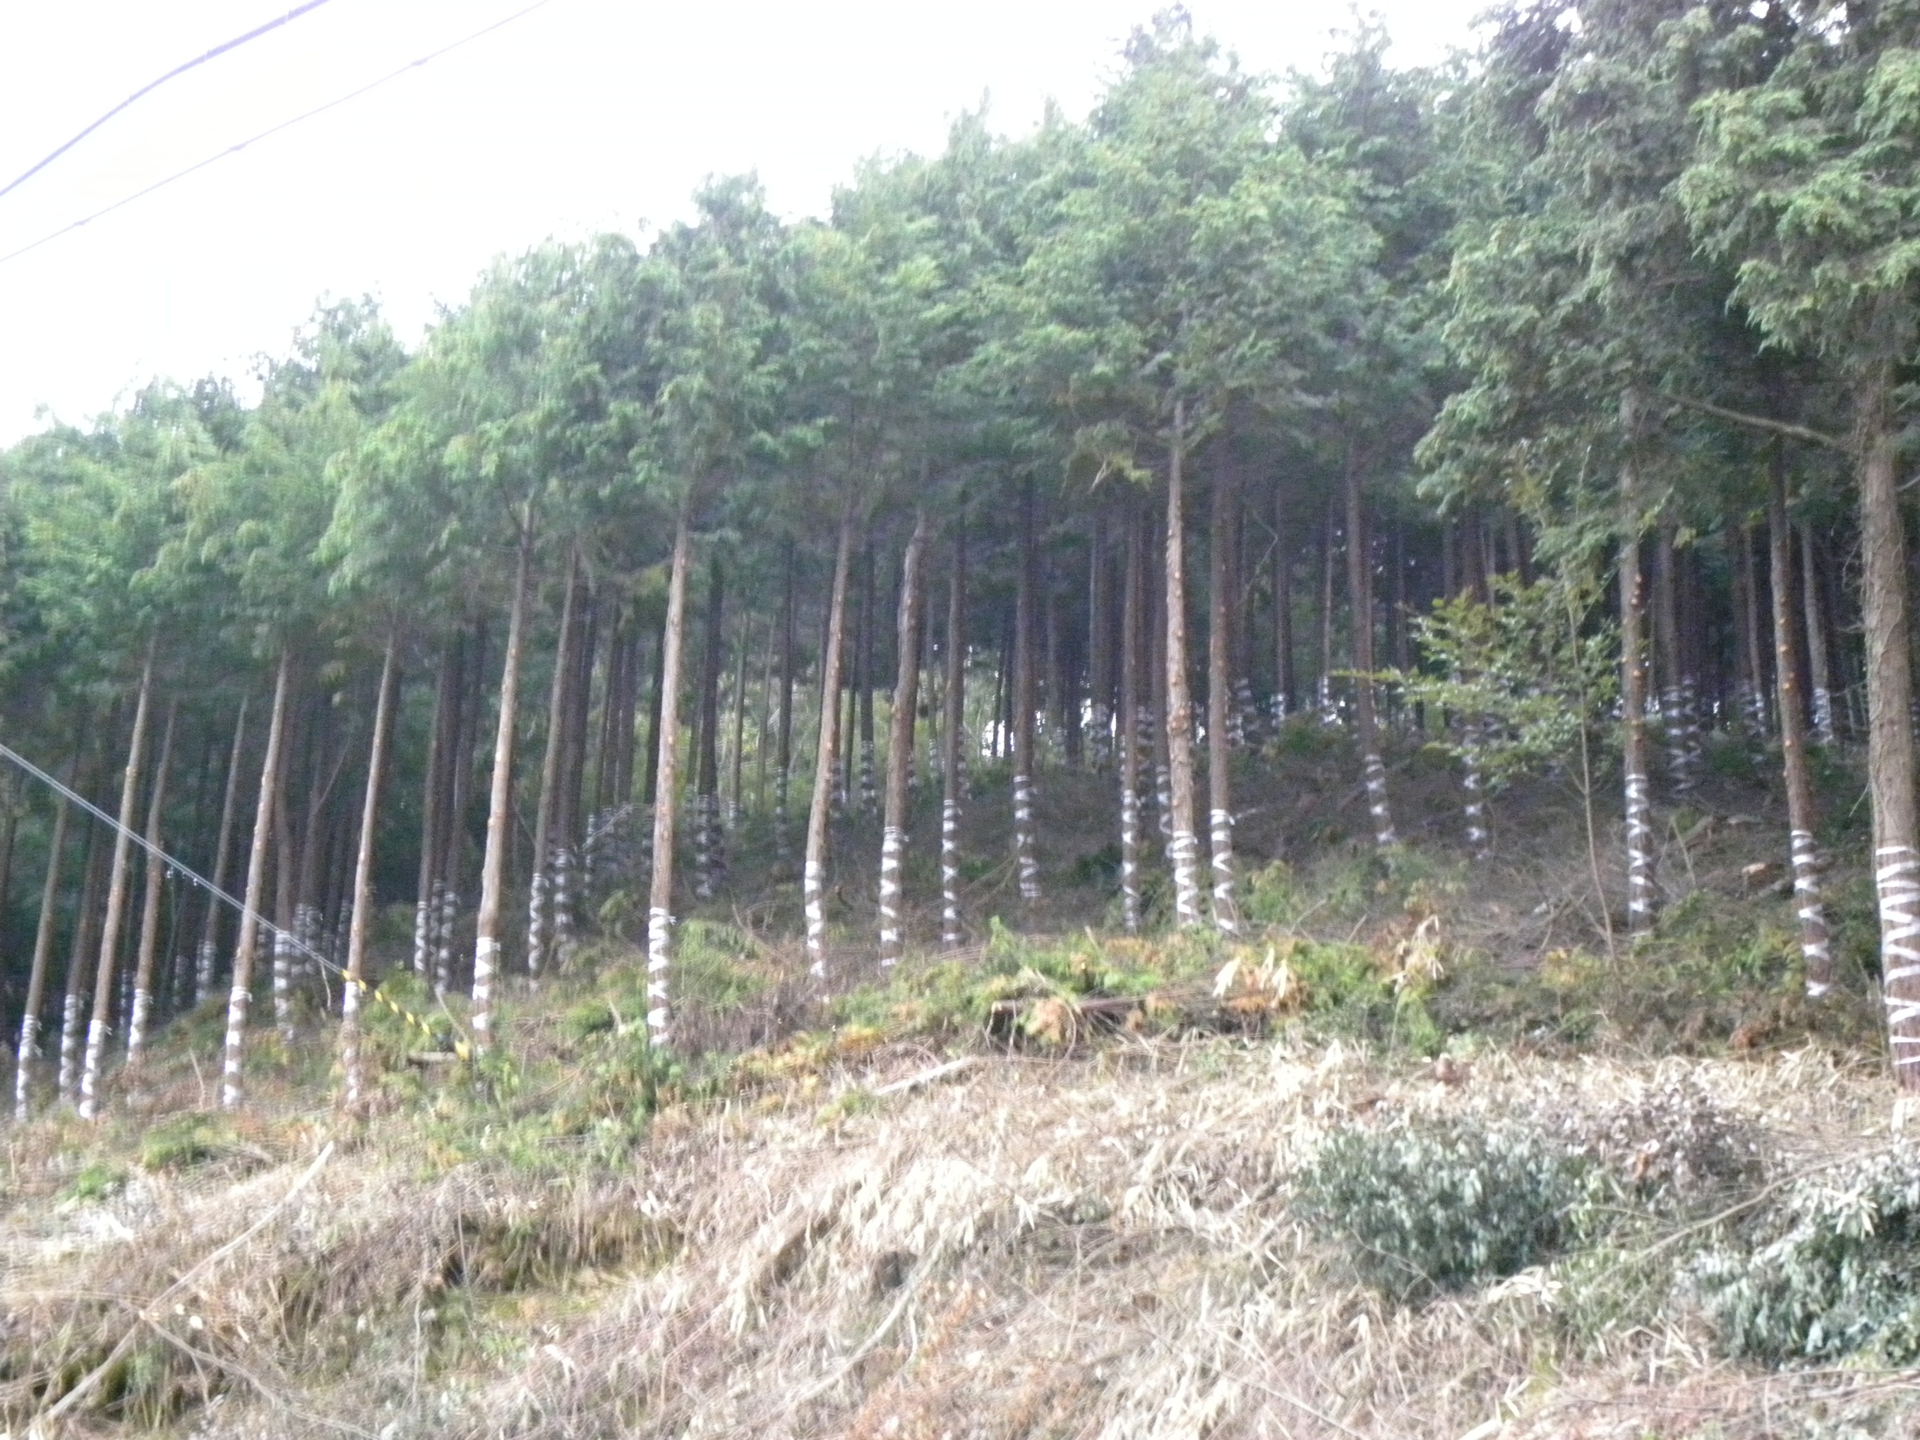
Oct. 16th, 2009 at Kyoto

Slide 30
3. Brief discussions
Japanese citizens are now faced with the following options.
  For humans to control the wild animal populations in some way (option 1). NOT SUCCESSFUL
  To return to the past conditions (option 2).
  NOT REALISTIC
  To transit to new conditions (option 3).
  MOST REALISTIC
  To do nothing (option 4).
  OUT OF QUESTION

Slide 31
Measures for preventing wildlife damage include three main components: damage control, population control, and habitat control.
OPTION 2
population control
(e.g. reintroduction of wolves)
Back to past conditions
OPTION 1
(e.g. hunting)
damage control
Maintain current conditions
OUR METHOD
habitat control
    It can be pointed out that human hunters are the last hunters of ungulates in Japan and they are now an endangered species.
    It should be that people hunt because there is a high demand for venison. However, in reality, they try to create demand because they hunt.

Slide 32
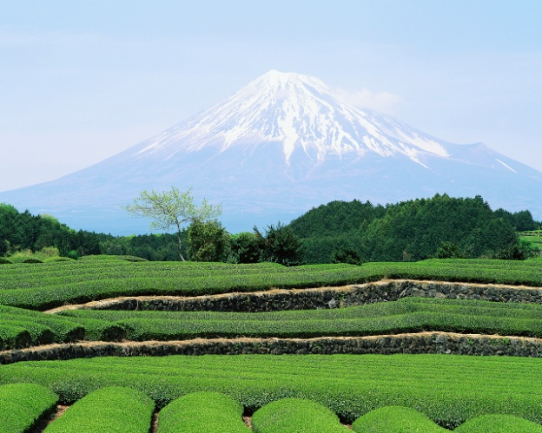
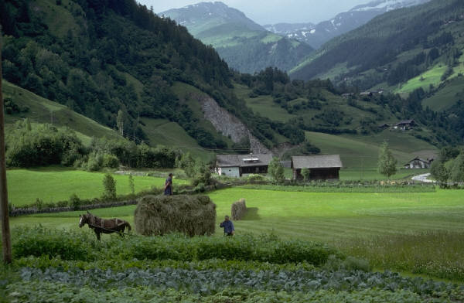
3.1. Main Proposal
One of the most realistic proposals is to divide mountainous regions into two groups.
maintain
abandon
Some regions should be maintained or reinvigorated...
But others can be left to remain in their natural state.

Slide 33
3.2. Several merits of this proposal
  First, we can concentrate on certain specific regions, which will help to save on maintenance costs and increases the possibility of successful maintenance of selected mountainous regions.
  Second, earlier, some ungulates such as sika deer used to range in the plain areas. By abandoning some regions, we can recreate their original habitat.
  Third, if we create a new habitat and rely on the ecosystem for its control to a certain extent, monkey issue (carcasses of monkey are currently of no use) will be less problematic.

Slide 34
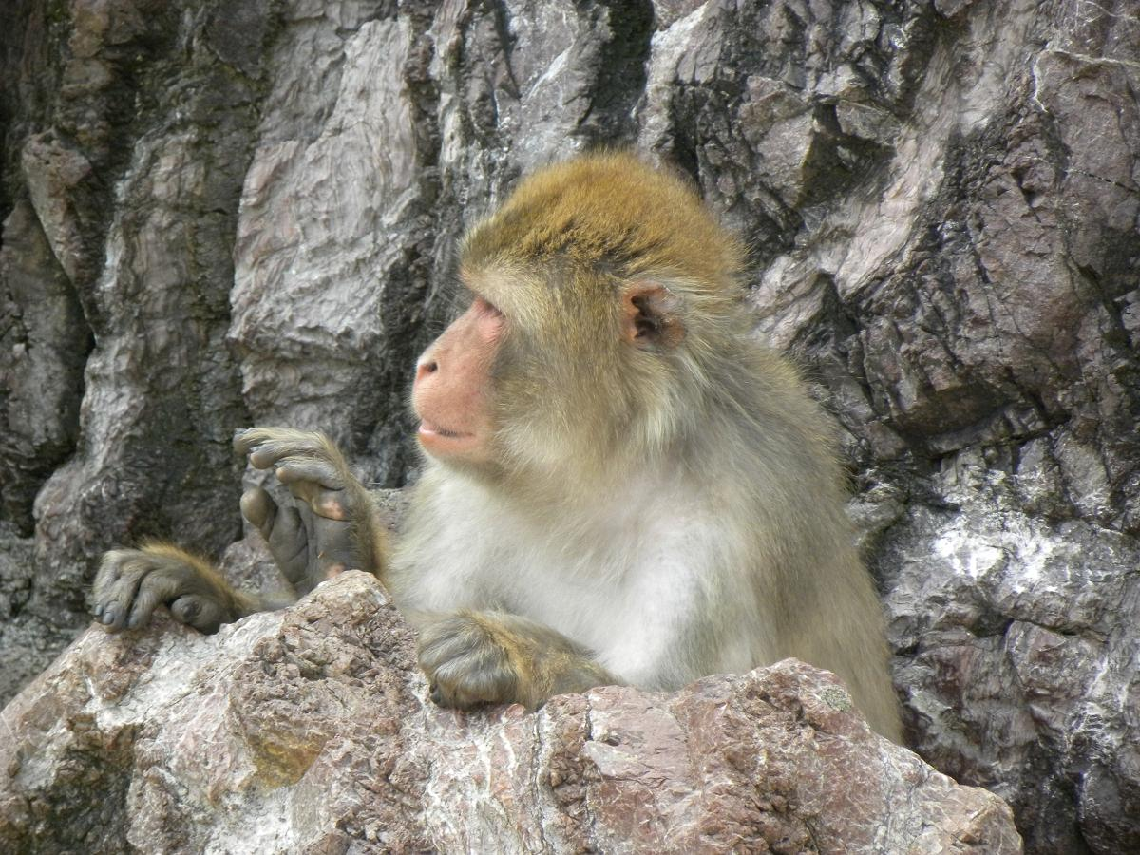
3.3. Remaining issues
The first is how to create and/or maintain buffer zones.
The second is how to monitor wildlife.
The third is how to maintain a small number of hunters. This is because there will be cases where we ask hunters to shoot wild animals with guns or tranquilizer guns.

Slide 35
Thank you for your attention.

